Slide 1
Responsive Design
Layout, UI and UX
for all your users

Slide 2
What is responsive design
Combination of
Fluid grids
Flexible images
Media queries
Notes:
"Responsive design", coined by Ethan Marcotte in A List Apart, refers to a set of technologies that make sites adapt to the form factor the site is viewed in. These technologies are:
Fluid Grids: All the content measurements are expressed in relative units to ensure that the layout will remain as consistent as possible across form factors
Flexible images: All images are expressed using relative units so that they resize along with the content
Media Queries: A way to rearrange your layout in CSS without modifying your HTML.

Slide 3
Why “responsive design”?
Different users
Different devices
Different data needs
Notes:
Why worry about responsive design?
One size doesn’t fit all. Our content needs to work for different users, on different devices and with different needs. Some users will have unlimited data plans for their iPhone while others will have a very limited data budget for their feature phones using a proxy browser like Opera Mini.
We need layouts and content that work across devices. As soon as design doesn't adapt to the device, you break the illusion and lose trust.
Progressive web applications have Responsive Web Design as one of its core principles. It won’t matter how fast your application load if the content is the text size is too small to read on your phone or if pieces of your layout are not visible on a tablet.

Slide 4
Progressive Enhancement
If CSS supported
If JavaScript supported
HTML
HTML
+
CSS
HTML
+
CSS
+
Javascript
Notes:
As well as form factor and accessibility we must take into account device support for our app. The user may have outdated hardware/software that may not support some of our awesome responsive features. We need to make sure we provide a good default experience with a technology or language (such as HTML) that is widely supported, and then conditionally add the features we want based on support for those features.
Remember: The content is the most important part of our app. The goal of progressive enhancement is to preserve the content, so that if something breaks, our content will still be there in our default experience.
On the same note, progressively enhancing our app should not change the core content for different users (unless that's the desired result). The content should be the same for the user regardless of form factor or support for a particular feature. It may affect any styles, layout, responsiveness, performance, etc.
OLD STUFF BELOW (might be useful for the presenter to read before deleting so I'll leave it for now):
We then add CSS to change the style and, if necessary, the layout of our content. This is where we use media queries to change elements of our HTML content and where the layout will change to accommodate different users. The content remains the same… we are giving the same content to all our users
The last enhancement is to add Javascript for interactivity. The content for the site should display whether Javascript is enabled or not. These days it’s hard to accept that people may disable Javascript deliberately but it may happen so we need to take that possibility into account.
Whatever you do to enhance your content you need to be sure that the content remains readable to the user.

Slide 5
Sizing elements matters
Notes:
You can make the simplest site work well if you size elements and content correctly.

Slide 6
PWA golden rule
Never make users scroll horizontally
Notes:
Don't let content overflow horizontally, especially on mobile.
Sounds basic, but lots of site break this rule by making images, inputs and other large elements on the page with fixed sizes.
Using relative measurement units (em, rem, or percentages) will reduce the severity of this issue.

Slide 7
Viewport meta tag
<meta name="viewport" content="width=device-width, initial-scale=1">
Notes:
Adding a meta viewport tag will solve a lot of problems for mobile devices.
The meta viewport tag tells the browser the size of the virtual viewport on which it renders a web page. Setting the viewport meta tag correctly, browsers scale down a page to fit a (virtual) 980px wide viewport either by zooming into a portion of the page that matches the available screen size or by shrinking the page until it fits into the available viewport, rendering the text impossible to read.
The initial-scale value sets the zoom default for this page.
Note:
This will mess up the layout for fixed width sites. The meta viewport tag is designed to work with responsive layouts. If you use it in a fixed size layout it will break things until you convert the site to a responsive layout.

Slide 8
max-width
img {
max-width: 100%;
}
img.foo {
width: 300px;
}
Notes:
Using max-width will solve most of your problems with images.
The max-width property sets the maximum width of a given element. In the example, the maximum width of the image is 100% of the width of the parent element.
Because we’ve set a maximum width attribute the images will not be larger than the maximum-width specified in the image tag.

Slide 9
Relative sizing is not the (full) solution
One relative-sized layout for all
10% | 80% | 10%
Too big on desktop, too small on mobile
Notes:
So you might think relative sizing would fix everything.
For a while developers thought that relative sizing layout and images was enough. This is not always the case… Sometimes the design is too big on desktop and too small on mobile.

Slide 10
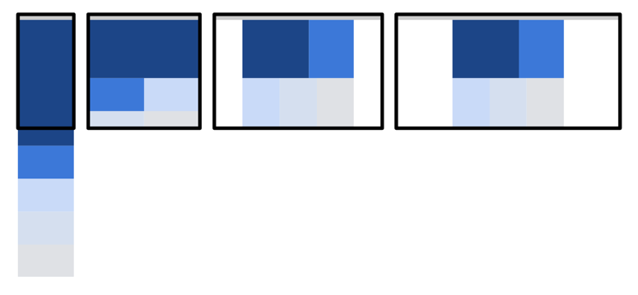
Enter media queries
Can use media queries to select layouts
Notes:
This is why media queries were invented.
It's a simple concept: modify the layout of your site based on different criteria (mostly width but not exclusively).
That doesn't just mean making the same layout fit every device.
On a phone you might want a single column layout, two column on a tablet, three column for desktop — and so on.

Slide 11
Media queries example
/* elements in common for phones and tablets */
@media (max-width: 480px) {
/* layout for phones */
}
@media (max-width: 720px) {
/* layout for tablets */
}
Notes:
If we only had to worry about devices this may be all the queries that we need to worry about, right?
Not quite so fast.

Slide 12
Mobile-first design

Slide 13
Media Queries: Select layout by device
320, 480px: phone
768px: tablet
992px: laptop
1200px: widescreen
Notes:
If we want to cover our bases with media queries then we need to worry about more than just phones and tablets. We have 4 queries to worry about for phone, tablet, laptop and widescreen devices. What happens if the phone or tablet is placed in landscape mode instead of portrait? What happens with retina devices?
We will soon find ourselves with a large number of media queries and a nightmare of managing a large CSS file and how it changes.
We’ll revisit these queries when we talk about mobile first design.

Slide 14
Revisiting responsive design
One stream of content
Find the best layout for devices and viewport sizes
Manipulate blocks of content for the needs of the layout
Notes:
As mentioned in a previous slide: Content is the most important part of our app.
We’re working with a single stream of content for all our layouts.
The first decision to make is what layouts we’ll use on the project and how we will manipulate the blocks of content to accommodate our layouts the same way we changed the layout from single column to two columns in tablets

Slide 15
Match breakpoints to content
Start small
Add major breakpoints
Add minor breakpoints if necessary
Optimize for reading: 70–80 characters per line
Notes:
Devices keep changing and devices viewports are getting bigger — and smaller. Add pixel density, pixel shape, display quality — and so on.
Don't force your designers and developers to make a change every time a new device appears.
Start the design process with the smallest form factor.
Then add the major breakpoints for the form factors that you will work with: phone, tablets, laptops and wide screen devices.
You can then create minor breakpoints to handle specific changes to elements that don’t affect all elements.
The final detail to keep in mind is to optimize the content for reading. Ideally keep the width of your content to 70 to 80 characters. Wider than that value makes content harder to read.

Slide 16
Content-based media queries
Understand your users
Understand your target devices
Design content
Use media queries to select layouts
Notes:
That doesn't mean you stop thinking about devices and device classes: you might want one column for phones, two columns for tablets, three columns for desktop — or whatever.
You can find more about these recommendations on Web Fundamentals.

Slide 17
Mobile first media queries
/* small */
@media (min-width: 480px) {
/* medium */
}
@media (min-width: 720px) {
/* large */
}
Notes:
Remember the earlier media queries example?
In the mobile-first world of PWAs, we need to turn that around. Here we are using min-width instead of max-width in our media queries to handle medium and large form factors as the exception.
Example here.
By the way — there is no fixed rule about whether or not to include media queries inline or use a separate file.
Also — you might want to consider using ems or rems for units here (but I won't go into that now).

Slide 18
You can also use JavaScript
var min = '(min-width: 25em)';
if (window.matchMedia(min).matches) {
/* include something */
}
Notes:
This is a simple way to do conditional content.
matchMedia() is well supported, and there are polyfills.

Slide 19
...and don't forget calc()
img.thumb {
margin-right: 10px;
max-width: 400px;
width: calc((100% - 10px) / 2);
}
img.thumb: last-of-type {
margin-right: 0;
}
Notes:
calc() is really useful in responsive design where you want

Slide 20
Content first

Slide 21
Manipulating content
Reorder
Reposition
Replace
Remove (last resort)
Notes:
(I guess the point here is to make the most important content the most visible and easiest to access. - Nick)
Responsive design is about more than just changing layouts.
Media queries can do more than just change layouts, they also allow designers to manipulate content, depending on the viewport size and device type.
On a phone, you might want to make sure page content is visible when the user goes to your home page — so you might opt for a hamburger menu for navigation, and move ads lower on the page.
As a very last resort we can remove content. However, this is not recommended:
Plan content and functionality carefully.
Don't guess your users needs based on viewport size.
Don't assume users want less content or less functionality on phones than desktop. Remember that we can change the layout for different types of device so we don’t need to remove content for the sake of smaller devices.
Understand your users, don't second guess them. If available use data driven design!

Slide 22
Keep it as simple as possible
Help users get to content
Notes:
Every step to get to content loses 20% of users.
Design content, layouts and transaction process so users can get to what they want as quickly as possible.
<more text here to fill this out>

Slide 23
Content choice
Images, e.g. different crop or different image
Video, e.g. different resolution
Notes:
A better alternative to removing content is to use content appropriate to the displays you’re targeting
For video, a very sensible option is to choose a smaller resolution for smaller viewports. This can result in massive improvements. The modern way to do it is with DASH, not media queries, but if you're serving for mobile only, keep it small!
For images, this is called art direction: choosing different images or image crops depending on the target device or designer intention. We’ll talk about art direction again in the responsive images module.

Slide 24
Layout

Slide 25
The common way...
12-column grid: Bootstrap/MDL/...
Fixed breakpoints and fixed sized per device family
CSS classes set block widths in columns
Pros: easy, well-understood
Cons: data usage, fixed widths
Works poorly on some devices, content
Notes:
Using a library or framework may get you started quickly, but it will add data cost.
You also need to make sure you know what your code is doing: to build a great PWA, avoid 'black box coding'.
We want to understand simple techniques that you can use in pure CSS.

Slide 26
Resources
Resources
Responsive Web Design
7 habits of highly effective media queries
Using Media Queries
Ish
Web Fundamentals
Do as little as possible

Slide 27
Lab Overview
Set the visual viewport and style the page with CSS
Add breakpoints to your content
Use a grid layout
Use Flexbox

Slide 28
Extra Credit: Flexbox

Slide 29
CSS Flexbox
Flexible sizing and alignment
Element reordering
Better performance than floats
Notes:
CSS Flexbox is well supported, and we strongly recommend it.

Slide 30
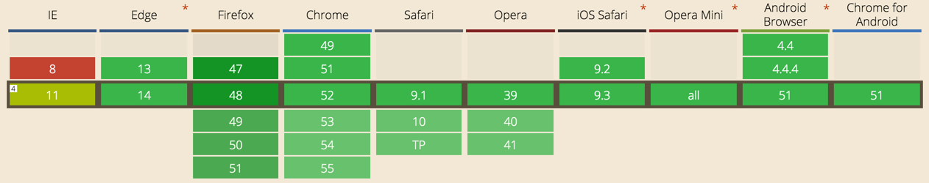
CSS Flexbox: good support
Notes:
CSS Flexbox is well supported, and we strongly recommend it.

Slide 31
CSS Flexbox: centering
.container {
display: flex;
height: 300px;
}
.child {
height: 100px;
margin: auto;
width: 100px;
}
Notes:
It's the Holy Grail!
Take a look at this.

Slide 32
Layouts for different viewports: 1
.container {
display: flex;
flex-flow: row wrap;
}
.child1, .child2, .child3, .child4, .child5 {
width: 100%;
}
Notes:
Let's look at the CSS for the example here.
This uses CSS Flexbox for three different layouts, depending on the viewport width.
Let's start with the defaults for smaller viewports — remember, mobile first!
The container is declared to use CSS flex. The flex-flow property means child elements can wrap, rather than all being squashed onto the same line. You can also use inline-flex.
It's shorthand for flex-direction and flex-wrap properties. The default is row nowrap.
100% width for each div in the container.

Slide 33
Layouts for different viewports: 2
@media (min-width: 600px) {
.child2, .child3, .child4, .child5 {
width: 50%;
}
}
Notes:
...add a different layout for a slightly larger viewport.

Slide 34
Layouts for different viewports: 3
@media (min-width: 800px) {
.container {
margin-left: auto;
margin-right: auto;
width: 800px;
}
.child1 { width: 60%; }
.child2 { width: 40%; }
.child3, .child4, .child5 { width: 33.33%; }
}
Notes:
...and different again once the width hits 800px.
The container is now a fixed width and centred horizontally using margins.

Slide 35
CSS Flexbox for ordering: 1
.container {
display: flex;
flex-flow: row wrap;
}
.child1, .child2, .child3 {
width: 100%;
}
Notes:
Let's take a look at the example here.
Once again this uses CSS Flexbox for three different layouts, depending on the viewport width.
And again, let's start with the defaults for smaller viewports.

Slide 36
CSS Flexbox for ordering: 2
@media (min-width: 600px) {
.child1 {
order: 2;
width: 60%;
}
.child2 {
order: 1;
width: 40%;
}
}
Notes:
For viewports over 600px in width, the order is changed.
On the smaller viewports, we wanted to give child1 full width. But for a slightly larger viewport, we can put it next to child2.

Slide 37
CSS Flex: more
flex-direction
justify-content
align-items
Notes:
I could go on…
Two other properties I'd like to draw your attention to.
justify-content: how items are packed
align-items: how items are aligned

Slide 38
CSS Grid
Oriented to two-dimensional layout
Works with CSS Flexbox
Optimized for UI design
Separation of layout and content
Notes:
CSS Grid is in some ways related to the 'grid system' concept familiar to graphic designers.
A page is thought of in terms of lines, tracks (between lines), cells and areas.

Slide 39
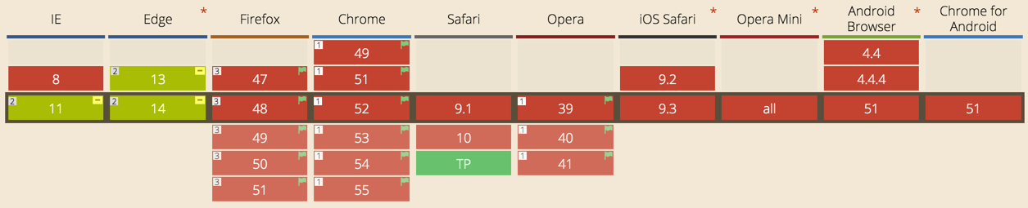
CSS Grid: get ready
Notes:
CSS Grid is coming — and it's already behind a flag in Chrome and Firefox.
More information here and here.

